Slide 1
Statistical modeling of spiking activity in large scale neuronal networks - Ryan Christopher Kelly
By
Akhil

Slide 2
Questions ?
What are the underlying sources of the apparent randomness of individual neurons’ spiking activities?
2. How can we measure and understand correlated activity measured in a population of neurons?

Slide 3
Background:
Most striking feature of spike trains is their variability
This variability is because of noise. This just means there are some factors which we are not considering.
Some of the factors
the firing of neurons has been strongly linked to
ongoing population activity -- Neurons transition between “Up” (depolarized) and “Down” (hyperpolarized) states
local field potential (LFP).
These factors could account for some variability
LFP could be a candidate signal
Reasons:
slow dynamics of spiking activity can be inferred from the LFP
phase of the LFP is predictive of multi-unit activity
Why not :
spatial spread - few hundred microns to more than a few millimeters
depend on laminae and frequency
LFP, neuronal states, and spiking activity are related but don’t know how to disentangle them
Notes:
– that is, the same visual stimulus does not elicit the same spike pattern on repeated presentations. This variability is often considered to be “noise,” meaning that it is due to unknown factors. Identifying these unknowns should enable better characterization of neural responses. One effect of cross trial fluctuations that has received a great deal of attention is correlation between neurons.
, which leads to cycles of higher and lower than normal firing rates
local field potential (LFP) is an electrophysiological signal generated by the summed electric current flowing from multiple nearby neurons within a small volume of neuronal tissue.
LFP: it reflects the average synaptic inputs to a region near the electrode + known to be correlated with the subthreshold membrane potential fluctuations in nearby neurons

Slide 4



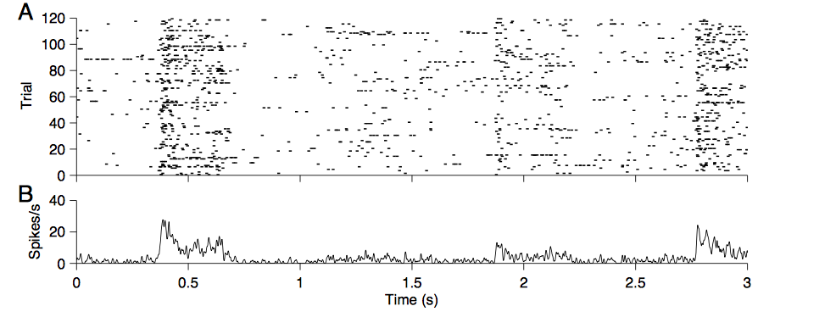
Neural stochasticity
averaging can also be applied across a trial at fine timescales:
assuming stationarity of the noise:
Notes:
Neurons are often conceptualized as inherently stochastic from a systems level
potential conception is that the firing rate is due to a stimulus effect plus some independent noise:
same grating movie
PSTH has been smoothed with a Gaussian window

Slide 5
The method of explicitly decomposing the different contributions on firing allows for an alternative and more targeted estimation of the functional connectivity among a group of cells
Computational challenges
Dimensionality can be huge: for each time interval to be estimated, there are 10,000 or more parameters of the other cells and network that may be related to firing.
To model stimulus effects, a 320 × 320 pixel movie can have 108 or more relevant parameters.
Notes:
– that is, the same visual stimulus does not elicit the same spike pattern on repeated presentations. This variability is often considered to be “noise,” meaning that it is due to unknown factors. Identifying these unknowns should enable better characterization of neural responses. One effect of cross trial fluctuations that has received a great deal of attention is correlation between neurons.
, which leads to cycles of higher and lower than normal firing rates
LFP: it reflects the average synaptic inputs to a region near the electrode + known to be correlated with the subthreshold membrane potential fluctuations in nearby neurons

Slide 6
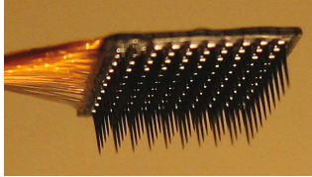
Data and methods:
Microelectrode array data collection (Cyberkinetics “Utah” Array)
quality and stability of neural spike train recordings
General conclusion
The signal-to-noise quality of the array data is roughly comparable to single electrode data from published studies
The temporal stability of the recordings is on the order of hours. Thus the quality of data is suitable for the application of the GLM techniques
Cyberkinetics “Utah” Array -10 by 10 grid – 1mm deep
recordings confined mostly to layers 2–3 of parafoveal V1 (receptive fields within 5◦ of the fovea)
Signals from each microelectrode were amplified and bandpass filtered to get spiking data
Notes:
– that is, the same visual stimulus does not elicit the same spike pattern on repeated presentations. This variability is often considered to be “noise,” meaning that it is due to unknown factors. Identifying these unknowns should enable better characterization of neural responses. One effect of cross trial fluctuations that has received a great deal of attention is correlation between neurons.
, which leads to cycles of higher and lower than normal firing rates
local field potential (LFP) is an electrophysiological signal generated by the summed electric current flowing from multiple nearby neurons within a small volume of neuronal tissue.
LFP: it reflects the average synaptic inputs to a region near the electrode + known to be correlated with the subthreshold membrane potential fluctuations in nearby neurons

Slide 7
On average, the recording quality is somewhat lower than that of single electrodes, but nonetheless the assessment of tuning properties such as the spatiotemporal receptive field and orientation tuning remains unchanged.
Overall, we found that tuning properties were similar to those previously reported for orientation tuning (Hubel and Wiesel, 1968; Ringach et al., 2002b) and STRFs
On a population level, SNR values for the arrays tended to be somewhat lower than those from single electrode recordings in both macaques and cats
Studied the responses of cells to visual stimuli, presented on a computer screen
Data recorded from arrays implanted into V1 of anesthetized monkeys
resolution of 1024 × 768 pixels and frame rate of 100 Hz
Four kinds of stimuli were presented: gratings, natural movies, gaussian white noise movies, and a blank screen
Gaussian white noise movies, with 8 pixel spatial blocks chosen independently from a gaussian distribution. The movies were 5◦ in width and height, 320 by 320 pixels
Notes:
– that is, the same visual stimulus does not elicit the same spike pattern on repeated presentations. This variability is often considered to be “noise,” meaning that it is due to unknown factors. Identifying these unknowns should enable better characterization of neural responses. One effect of cross trial fluctuations that has received a great deal of attention is correlation between neurons.
, which leads to cycles of higher and lower than normal firing rates
local field potential (LFP) is an electrophysiological signal generated by the summed electric current flowing from multiple nearby neurons within a small volume of neuronal tissue.
LFP: it reflects the average synaptic inputs to a region near the electrode + known to be correlated with the subthreshold membrane potential fluctuations in nearby neurons

Slide 8
Shared noise and neural stochasticity
In many cases the state of the larger network can profoundly affect cell spiking, and can even rival stimulus driven behavior in magnitude. This network state can be estimated with the band-passed electrode signal (given here by the LFP)
To model cell firing, we used the generalized linear model (GLM)
Proposed to use the LFPs as a proxy for a latent network state variable
Improvement in the signal-to-noise ratio of orientation tuning curves of neurons with these models, which suggests that the LFPs can be used to estimate the network state which contributes to neural firing.
Notes:
simultaneously recorded single- and multiple-unit neuronal activity (sorted offline) and LFPs from 100-electrode Utah arrays implanted in V1. We measured responses to sequences of sinusoidal gratings and natural movies as well as spontaneous activity with a mean gray screen.

Slide 9
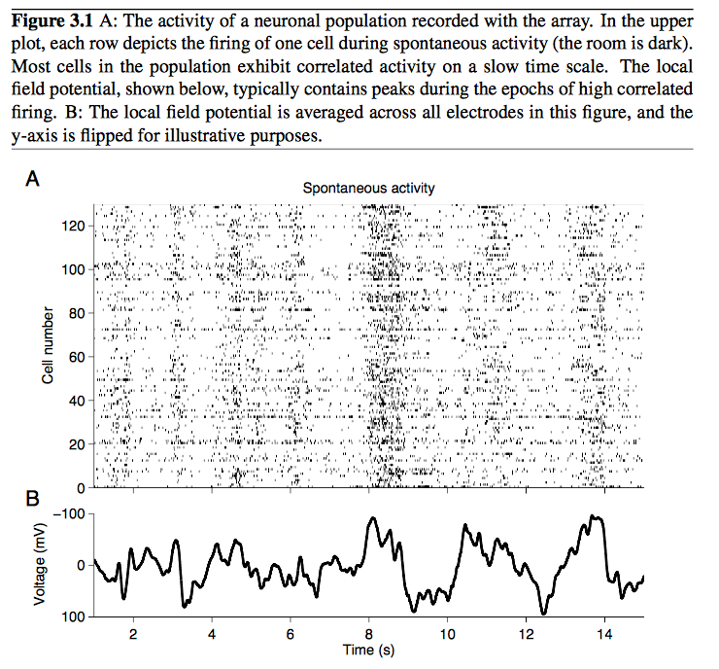
Notes:
Correlated fluctuations in spiking and the local field potential
We compared the LFP (Figure 3.1B recorded simultaneously) with the spontaneous spiking activity in a population of neurons. We found that the states which contained a large number of spikes (“Up”, or depolarized states) tended to correspond to large negative fluctuations in the LFP. Similarly, the absence of spikes (“Down”, or polarized states) correspond to positive trends in the LFP.
This plot is for spontaneous activity however for similar fluctuations are present with visual stimulus

Slide 10
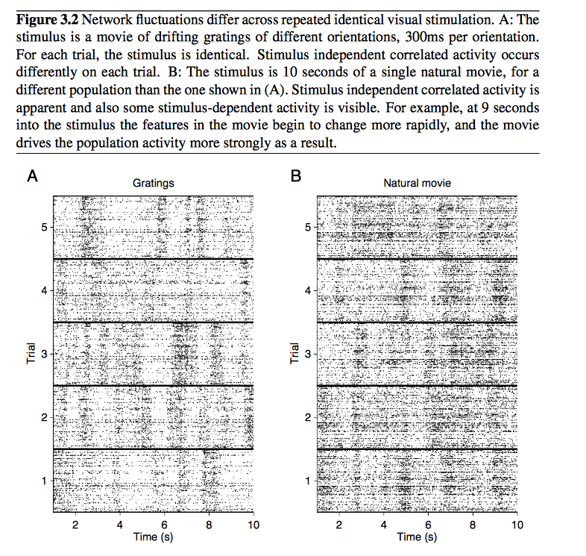
Notes:
Thus, the presence of a period of high activity on one of the trials that does not occur at the same time on all of the trials represents an “Up” state. Because the neurons prefer different orientations, there is no period in the grating sequence during which all of the neurons tended to fire in response to the visual stimulus. For this reason, the “Up” states were easy to identify. For the five identical natural movie repeats (Figure 3.2B), stimulus-dependent and indepen- dent correlated activity were more difficult to separate. Although correlated “Up” states are present, there were also periods of high activity in the entire population corresponding to stimulus events, presumably abrupt scene transitions, that altered the response of a large group of the recorded neurons. This mingling of stimulus-driven and state-driven activity makes it difficult to decode the signals sent by the spikes from a single neuron.

Slide 11
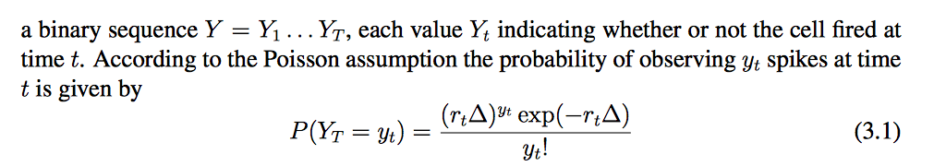


Model:
The complete time duration of spike train is divided into time bins of duration 1 ms, ensuring that each bin has at most one spike due to the natural refractoriness of neurons. A spike train may thereby be considered
where rt is a rate parameter for the process at time t and ∆ = 1 ms
likelihood of observing the entire spike train Y = y1 . . . yT
Notes:
rate parameter r is an unobservable property of the neuron and time step, and we proceed by fitting r so that this likelihood value is maximized.
where r(i) is the expected number of spikes at time t from cell i, s(i) is the stimulus- tt
dependent component of cell i’s firing rate, x(i) is an independent variable corresponding t
to the LFP value (taken to be an indication of the local network activity) at time t, and β(i) is a constant which controls the extent to which the network state affects the firing of cell i.

Slide 12

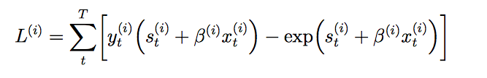

Notes:
where r(i) is the expected number of spikes at time t from cell i, s(i) is the stimulus- tt
dependent component of cell i’s firing rate, x(i) is an independent variable corresponding t
to the LFP value (taken to be an indication of the local network activity) at time t, and β(i) is a constant which controls the extent to which the network state affects the firing of cell i.
make up the best model of r(i) given the data

Slide 13
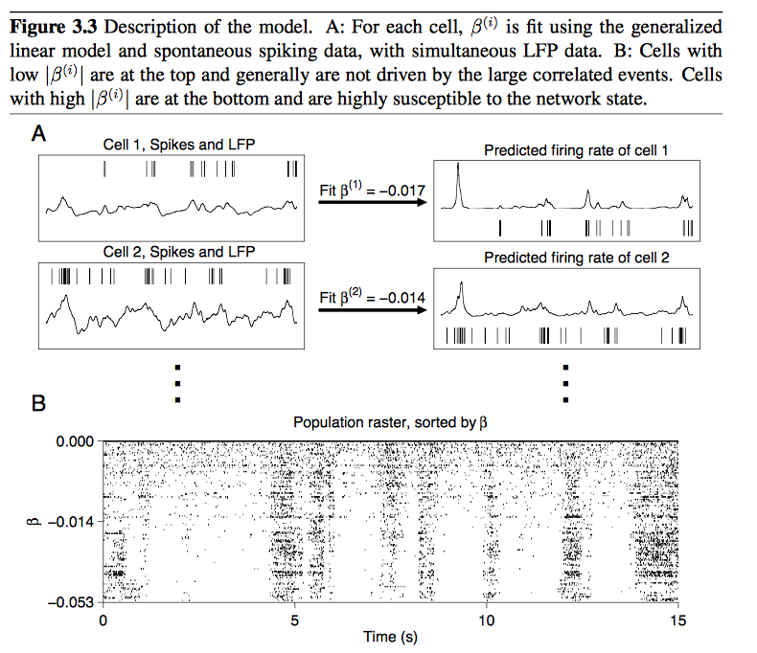
Notes:
On the left, spikes are shown along with the corresponding LFP from the same electrode. The predicted firing rate function after the fitting procedure is shown on the right along with the actual spike train.
The value of β varied across neurons in the population – some cells tended to be more influenced by network state than others.
To give context for the values of β, a value β = −0.017 means that an LFP change of −100 mV predicts a 5.5 fold increase in firing rate. A value β = 0.014 predicts for the same LFP change, a 4 fold increase in firing rate. The raster plot in Figure 3.3B, sorted by β, demonstrates this trend. LFP value is often linked to negative population spikes, and almost all of the cells show the dependence of negative LFP value on spiking. Neurons in the upper rows of this plot tended to not be very influenced by network state, and thus had low β values. They also tended to have higher firing rates (r =0.48, p <0.0001). Neurons in the lower rows of the plot had a strong tendency to fire during negative inflections of the LFP, and thus had highly negative β values. In the extreme, those neurons tended to fire only during “Up” states.

Slide 14

While LFPs reflect signal from a larger region of tissue, they also tend to cohere more for nearby electrodes than distant ones.
If the network- driven activity is one source of correlation between spiking neurons, it is likely to also show a distance dependence.
Since s(i) was just a constant c(i) when the stimulus is constant (a mean gray screen), we fit β(i) with spontaneous activity data, which is the simpler formula
Notes:
Once we determined the value of β(i) for each neuron i during spontaneous
activity, we assumed that the relationship between spiking and the network state (LFP
value x(i)) remained the same during visual stimulation. We thus fit s(i) using the LFP tt
and spiking data from repeated trials of drifting grating recordings, now holding β(i) fixed.

Slide 15
For most cells in the populations, selectivity was improved when accounting for the ongoing network activity with the LFP factor. The LFP was from the same electrode that recorded the cell’s activity.
Used the LFP as a signal to reflect network state
In addition, the LFP is a better indicator of the network state than the spike trains of other neurons, and produces larger decreases in variability using our model.
Notes:
Fluctuations in field potentials have long been known to be related to spiking activity. However, the full relationship between the LFP and spiking activity has been still the subject of interest

Slide 16
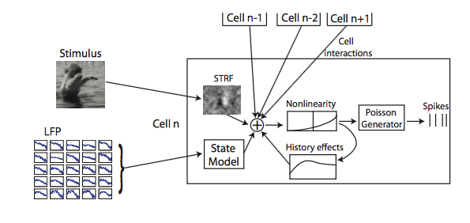
Computational framework and evaluation
Notes:
This model contains more parameters for a given predictor (e.g. the LFP value on multiple electrodes) and uses all the data at our disposal (the stimulus, other cell spikes, and the LFP). This increase in the model size presents a series of computational constraints on processing speed, memory, and storage space. In addition, the spike time series are rela- tively sparse, so a large model is underconstrained even when fit with a large amount of data. To deal with the data limitation we harness the power of the L1 regularization path algorithm from Park and Hastie (2007). To fit the models as fast as possible we imple- mented a version of coordinate descent, inspired by a similar implementation in Friedman et al. (2008).

Slide 17


we describe the simulation of data, and then in the following section we will attempt to recover these parameters by fitting a GLM to the simulated data.
Notes:
where the three components are the stimulus effect kiIi, the contributions from history and other cells αiri, and the contribution from the network state βisi. A further specification for these terms follows.

Slide 18

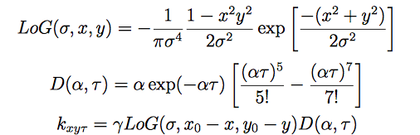
Stimulus effects
Spike effects
For the inputs from other cells, the term α can be either positive or negative, reflecting excitatory or inhibitory input, respectively. For the history term, α is taken to be negative, simulating a reduction in firing rate following spiking, or refractory period.
Notes:
The kernel for the simulated cell has one parameter for each spatio-temporal pixel. We simulated kernels of cells using the following equations
these parameters to roughly match the temporal and spatial shape of V1 receptive fields.
Stimulus effects
For the inputs from other cells, the term α can be either positive or negative, reflecting excitatory or inhibitory input, respectively. For the history term, α is taken to be negative, simulating a reduction in firing rate following spiking, or refractory period.

Slide 19

Network effects
conceptualized as the network state effect
Simulation of spike trains
Determined whether or not a spike occurs at time t by sampling from a Poisson distribution with parameter μ(t)

Slide 20


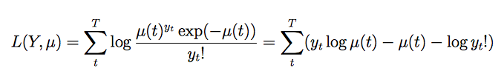
Model the spike train
Notes:
We model the spike train
Where f (y; μ) is the probability of observing y occurrences of an event in some window of time, and the parameter μ is the expected number of occurrences in that same window.
we characterize μ as a function in time, μ(t), and thus the likelihood of seeing all the responses Y = y1 . . . yT , where yt is the number of spikes observed in time window t
So the parameters βi, αi, kxyτ which maximize L are the maximum likelihood estimate for the cell, given the data xi and yi

Slide 21


Standard GLM fitting
To fit the parameters θ = {βi,αi,kxyτ}we can use any convex nonlinear optimization
approach
iteratively reweighted least squares (IRLS)
Regularized GLM fitting
To solve the overfitting problem, we take the approach of regularizing the GLMs
Regularization path
Instead of just performing the fit with a given λ, it computes all the fits for the whole λ path.
The model begins by underfitting the data and progresses through the path until it is finally overfitting the data . So it is important to halt the path algorithm before overfitting occurs.
Notes:
iteratively reweighted least squares (IRLS) which for our problem is equivalent to the Newton-Raphson method
The kind of neural data we have collected typically has a likelihood function which is relatively flat near its minimum :Part of the reason for this is a sampling problem: there simply are not enough spikes to locate the true parameters
L1 penalty term is particularly important to us here, because it reduces some of the coefficients of model parameters to identically zero, creating a sparse model
fitting a generalized linear model to models that include an L1 penalty is computation- ally difficult, because the function is no longer differentiable
Friedman et al. (2008) show how coordinate descent can successfully perform logistic regression on functions with L1 penalties
Friedman et al. (2008) show how coordinate descent can successfully perform logistic regression on functions with L1 penalties.
This method avoids a costly line search, and is capable of computing the solution along the whole path of an elastic net penalty

Slide 22
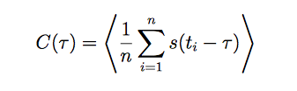

Modelling real neuronal signals:
Spatio temporal receptive fields
out of the 128 units recorded, 57 had by-eye localizable receptive fields
Notes:
where τ is the time interval preceding the spike, and s(t) is the stimulus value at time t

Slide 23
Consider a GLM model of the visual system where each neuron is independent and solely driven by a visual stimulus and noise
Using this GLM procedure, models are fitted to the spiking data for the cells in the population. The biggest obstacle is the huge dimensionality of the stimulus. If the pixel representation of the movies are used, and the last 150ms are relevant for spiking influence, there are 320 × 320 × 150 = 15, 360, 000 parameters . To reduce the parameters followed the following procedures
Space pruning
Stimulus transformation
Time pruning
Movie downsampling
Regularization paths
Used cross validation to estimate the performance of the models on 10 different test sets. The total number of data points for the 32 minutes of stimulus was 192,000. Thus each test set consisted of 12,000 test points and 180,000 training points. For each model created, we computed a ROC curve for each point in the regularization path. The point in the regularization path with the largest average area across all the cross validation runs was considered the optimal penalty.
Notes:
Movie downsampling: We reduced the movie to 160x160 by just considering every other pixel in each dimension. The resulting movie was 160x160.
Space pruning: Using the STAs computed above as guides, for the cells with visible receptive fields we located the approximate locations of the receptive fields. For each unit, an area of 40x40 pixels of the 160x160 original image was located.
Time pruning: The spike trains were binned at a 10ms resolution, with each bin containing the spike count within a particular 10ms. This reduced the number of temporal points in the model to 15 from 150.
Stimulus transformation: We transformed the stimulus into Gaussian bump responses, as in Chapter 4. The kind of bumps used are shown in Figure 5.6. The separation of the bump centers was 4 pixels spatially in the 40x40 pixel space, and 2 time points (20 ms). The total number of parameters was 10 × 10 × 7 = 700, which is 100 parameters for each of 7 distinct time points.

Slide 24

Functional connectivity
Found that for many cells, other cell influences are more valuable as a whole in predicting cell firing than the stimulus effects
Correlation – signal correlation and noise correlation
Signal – characterizes the relationship between two cells’ average firing rates to different stimuli.
Noise - is the tendency of cell responses to rise and fall together during the presentation of the
same or similar stimuli.
Noise correlation is given by Pearson correlation
Notes:
Of th paired spike count distributions n1,n2

Slide 25

cross-correlogram (CCG)
The CCG provides a way of measuring the relative spike timing of two neurons.
These analyses is that history is in most cases one of the most important predictors, but it is not by itself enough to achieve optimal performance.
For some cells, the stimulus carries the most information about spiking, while for others the spike coupling terms contain more relevant information
The stimulus coefficients correlate with terms from the spike-triggered average stimulus, and the spike coupling coefficients correlate with the corresponding pairwise noise correlation and cross-correlograms. One main difference in these measurements is that the L1 constraint encourages sparseness of nonzero coefficients, especially when the coefficients are correlated as many of these data are
Notes:
where M is the number of trials, N is the length of the trial (in ms), yij is the spike train function for cell j on trial i, τ is the time lag, and μ ̄j is the mean firing rate of the cell j. Tri is the triangle function which corrects for the amount of overlap in the two spike trains that differs with time lag.

Slide 26
One popular method for analyzing the LFP is frequency analysis
GLM is fitted using the following network state surrogates
• LFP value • Power in LFP frequency bands
• Phase and power • HMM built from the LFP
Main results of LFP analysis
some features of the LFP carry more information about spiking behavior than other features.
Ex:
power in the gamma frequency band is highly related to spiking in many cells
phase of the low frequency oscillations and the power in other frequency bands were less relevant for predicting spiking activity.

Slide 27
where Ixy (t) is the stimulus at spatial point (x, y), ri is the spike count for cell i in the last 100 ms, L is the LFP value, and P is the power in the LFP gamma band. The coefficients k, α, υ, β were all fit together.
Methods for fitting generalized linear models to spike trains using high dimensional data from the stimulus, spike coupling, and LFP. We have shown that variability in spiking to repeated presentations of identical stimuli can be explained in large part by the general network activity, in many cells
Applications:
Recovery of single trial firing rate functions and model assessment to the explanation of neural phenomena like correlation and synchrony.

Slide 28
Thank you

